Slide 1

Analysis of Large Graphs: TrustRank and WebSpam
Note to other teachers and users of these slides: We would be delighted if you found this our material useful in giving your own lectures. Feel free to use these slides verbatim, or to modify them to fit your own needs. If you make use of a significant portion of these slides in your own lecture, please include this message, or a link to our web site: http://www.mmds.org
Mining of Massive Datasets
Jure Leskovec, Anand Rajaraman, Jeff Ullman Stanford University
http://www.mmds.org

Slide 2
Example: PageRank Scores
B
38.4
C
34.3
A
3.3
D
3.9
E
8.1
F
3.9
1.6
1.6
1.6
1.6
1.6

Slide 3
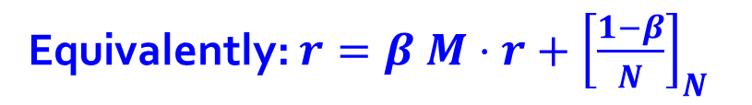
Random Teleports (β = 0.8)
M
[1/N]_{NxN}
0.8·½+0.2·⅓
y
1/2 1/2 0
1/2 0 0
0 1/2 1
1/3 1/3 1/3
1/3 1/3 1/3
1/3 1/3 1/3
0.8
+ 0.2
0.8·½+0.2·⅓
0.2·⅓
0.8·½+0.2·⅓
0.2· ⅓
y 7/15 7/15 1/15
a 7/15 1/15 1/15
m 1/15 7/15 13/15
0.8+0.2·⅓
a
0.8·½+0.2·⅓
m
0.2·⅓
0.2· ⅓
A
y
a =
m
1/3
1/3
1/3
0.33
0.20
0.46
0.24
0.20
0.52
0.26
0.18
0.56
7/33
5/33
21/33
. . .
r = A r

Slide 4
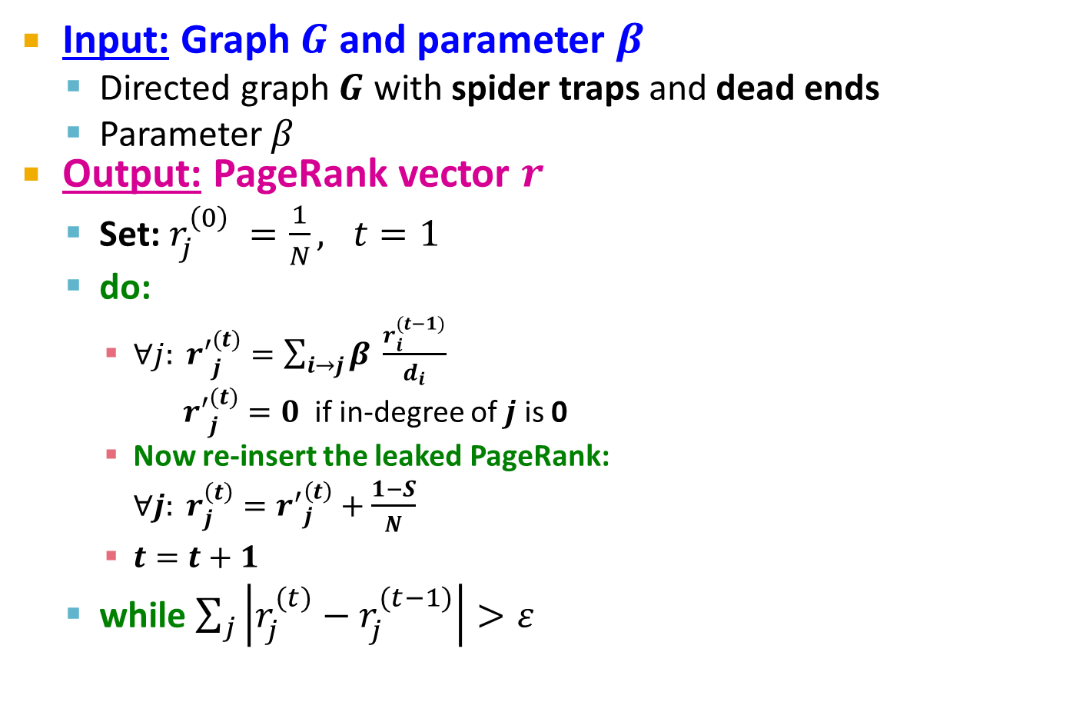

PageRank: The Complete Algorithm
If the graph has no dead-ends then the amount of leaked PageRank is 1-β. But since we have dead-ends the amount of leaked PageRank may be larger. We have to explicitly account for it by computing S.

Slide 5
Some Problems with PageRank
Measures generic popularity of a page
Will ignore/miss topic-specific authorities
Solution: Topic-Specific PageRank (next)
Uses a single measure of importance
Other models of importance
Solution: Hubs-and-Authorities
Susceptible to Link spam
Artificial link topographies created in order to boost page rank
Solution: TrustRank

Slide 6
Topic-Specific PageRank

Slide 7
Topic-Specific PageRank
Instead of generic popularity, can we measure popularity within a topic?
Goal: Evaluate Web pages not just according to their popularity, but by how close they are to a particular topic, e.g. “sports” or “history”
Allows search queries to be answered based on interests of the user
Example: Query “Trojan” wants different pages depending on whether you are interested in sports, history and computer security

Slide 8
Topic-Specific PageRank
Random walker has a small probability of teleporting at any step
Teleport can go to:
Standard PageRank: Any page with equal probability
To avoid dead-end and spider-trap problems
Topic Specific PageRank: A topic-specific set of “relevant” pages (teleport set)
Idea: Bias the random walk
When walker teleports, she pick a page from a set S
S contains only pages that are relevant to the topic
E.g., Open Directory (DMOZ) pages for a given topic/query
For each teleport set S, we get a different vector r_{S}

Slide 9
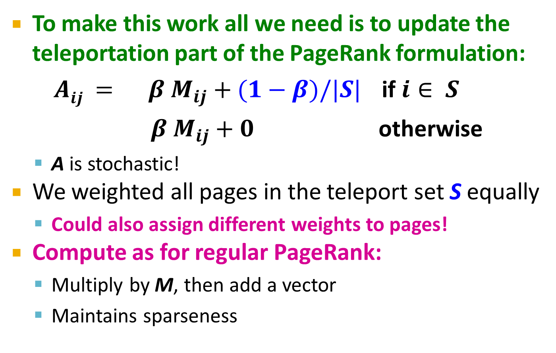
Matrix Formulation

Slide 10
Example: Topic-Specific PageRank
Suppose S = {1}, β = 0.8
0.2
0.5
1
Node Iteration
0 1 2 … stable
1 0.25 0.4 0.28 0.294
2 0.25 0.1 0.16 0.118
3 0.25 0.3 0.32 0.327
4 0.25 0.2 0.24 0.261
0.4
0.5
0.4
1
2
3
0.8
1
1
0.8
0.8
4
S={1,2,3,4}, β=0.8:
r=[0.13, 0.10, 0.39, 0.36]
S={1,2,3} , β=0.8:
r=[0.17, 0.13, 0.38, 0.30]
S={1,2} , β=0.8:
r=[0.26, 0.20, 0.29, 0.23]
S={1} , β=0.8:
r=[0.29, 0.11, 0.32, 0.26]
S={1}, β=0.90:
r=[0.17, 0.07, 0.40, 0.36]
S={1} , β=0.8:
r=[0.29, 0.11, 0.32, 0.26]
S={1}, β=0.70:
r=[0.39, 0.14, 0.27, 0.19]

Slide 11
Discovering the Topic Vector S
Create different PageRanks for different topics
The 16 DMOZ top-level categories:
arts, business, sports,…
Which topic ranking to use?
User can pick from a menu
Classify query into a topic
Can use the context of the query
E.g., query is launched from a web page talking about a known topic
History of queries e.g., “basketball” followed by “Jordan”
User context, e.g., user’s bookmarks, …

Slide 12
Application to Measuring Proximity in Graphs
Random Walk with Restarts: S is a single element

Slide 13
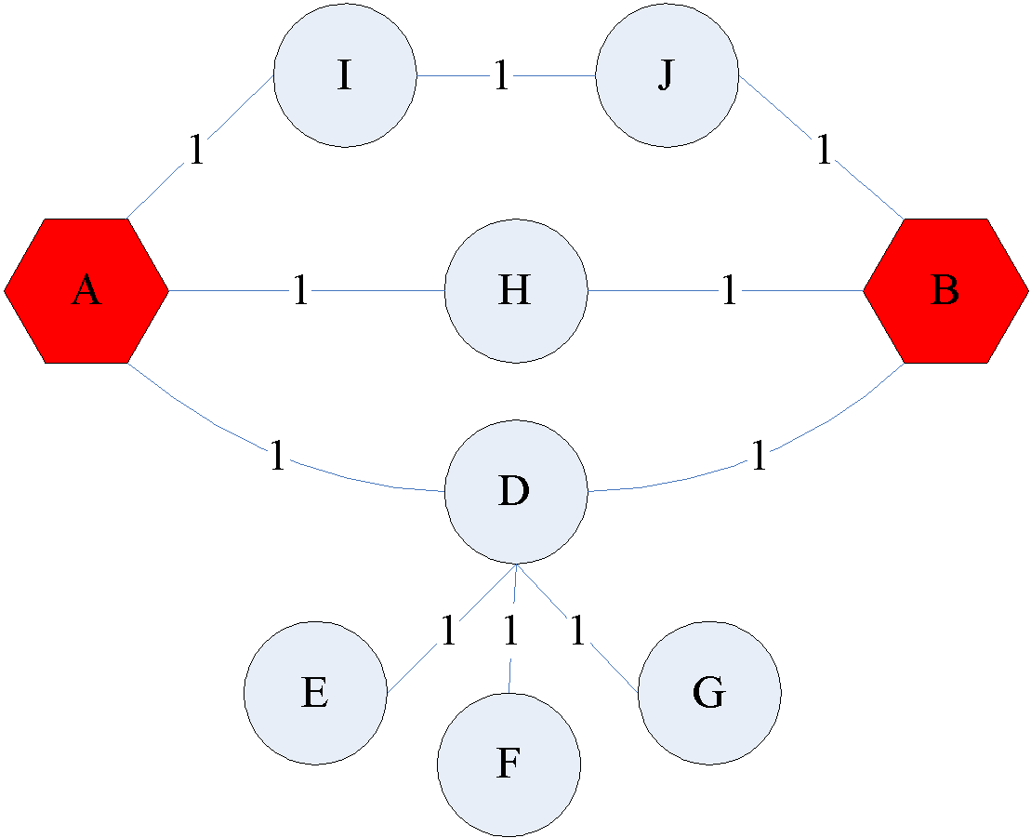
Proximity on Graphs
[Tong-Faloutsos, ‘06]
a.k.a.: Relevance, Closeness, ‘Similarity’…

Slide 14
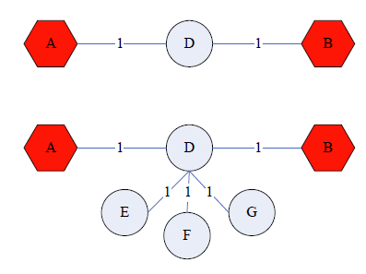
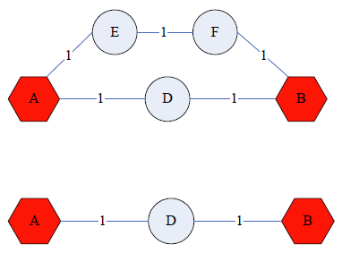
Good proximity measure?
Shortest path is not good:
No effect of degree-1 nodes (E, F, G)!
Multi-faceted relationships

Slide 15
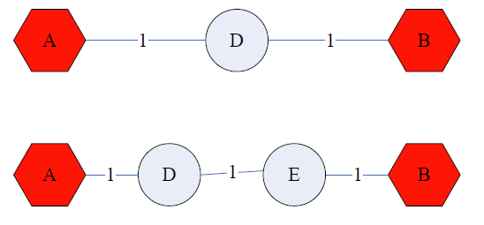
Good proximity measure?
Network flow is not good:
Does not punish long paths

Slide 16
What is good notion of proximity?
[Tong-Faloutsos, ‘06]
Multiple connections
Quality of connection
Direct & Indirect connections
Length, Degree, Weight…
…

Slide 17
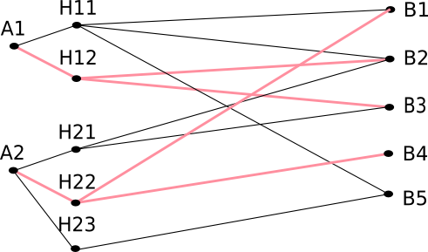
SimRank: Idea
SimRank: Random walks from a fixed node on k-partite graphs
Setting: k-partite graph with k types of nodes
E.g.: Authors, Conferences, Tags
Topic Specific PageRank from node u: teleport set S = {u}
Resulting scores measures similarity to node u
Problem:
Must be done once for each node u
Suitable for sub-Web-scale applications
Authors
Conferences
Tags

Slide 18
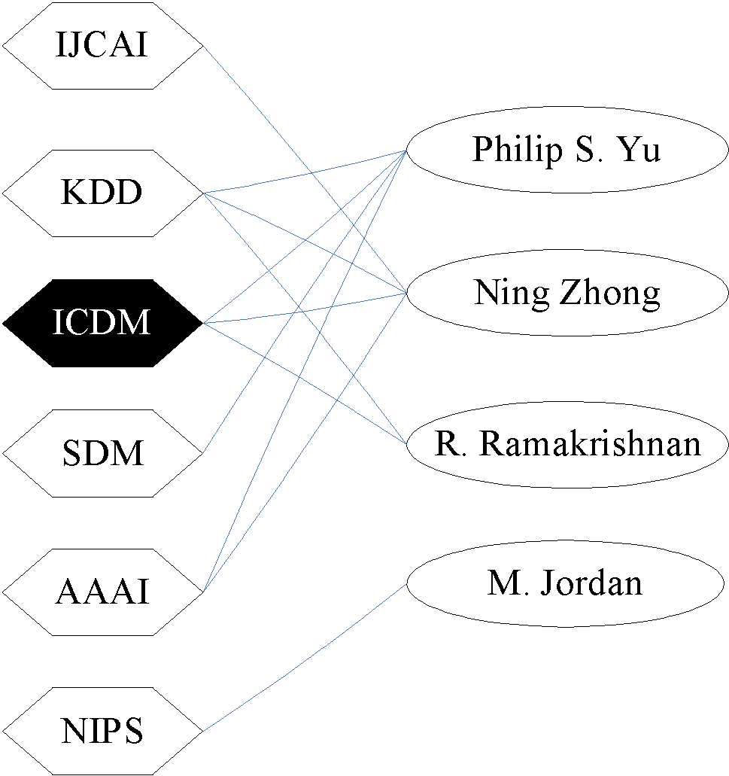
SimRank: Example
…
…
Q: What is most related
conference to ICDM?
A: Topic-Specific PageRank with teleport set S={ICDM}
…
…
Conference
Author

Slide 19
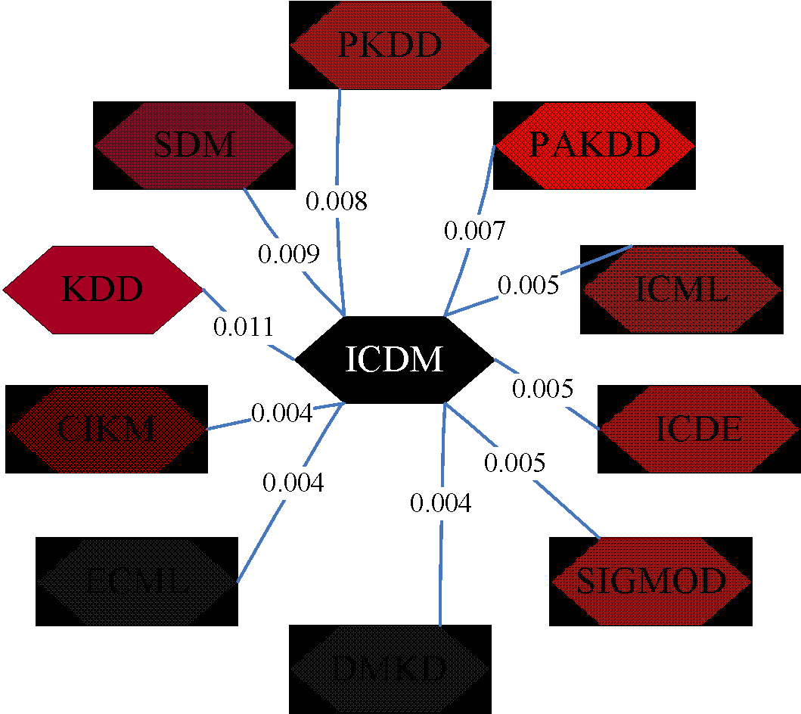
SimRank: Example

Slide 20
PageRank: Summary
“Normal” PageRank:
Teleports uniformly at random to any node
All nodes have the same probability of surfer landing there: S = [0.1, 0.1, 0.1, 0.1, 0.1, 0.1, 0.1, 0.1, 0.1, 0.1]
Topic-Specific PageRank also known as Personalized PageRank:
Teleports to a topic specific set of pages
Nodes can have different probabilities of surfer landing there: S = [0.1, 0, 0, 0.2, 0, 0, 0.5, 0, 0, 0.2]
Random Walk with Restarts:
Topic-Specific PageRank where teleport is always to the same node. S=[0, 0, 0, 0, 1, 0, 0, 0, 0, 0, 0]

Slide 21
TrustRank: Combating the Web Spam

Slide 22
What is Web Spam?
Spamming:
Any deliberate action to boost a web page’s position in search engine results, incommensurate with page’s real value
Spam:
Web pages that are the result of spamming
This is a very broad definition
SEO industry might disagree!
SEO = search engine optimization
Approximately 10-15% of web pages are spam

Slide 23
Web Search
Early search engines:
Crawl the Web
Index pages by the words they contained
Respond to search queries (lists of words) with the pages containing those words
Early page ranking:
Attempt to order pages matching a search query by “importance”
First search engines considered:
(1) Number of times query words appeared
(2) Prominence of word position, e.g. title, header

Slide 24
First Spammers
As people began to use search engines to find things on the Web, those with commercial interests tried to exploit search engines to bring people to their own site – whether they wanted to be there or not
Example:
Shirt-seller might pretend to be about “movies”
Techniques for achieving high relevance/importance for a web page

Slide 25
First Spammers: Term Spam
How do you make your page appear to be about movies?
(1) Add the word movie 1,000 times to your page
Set text color to the background color, so only search engines would see it
(2) Or, run the query “movie” on your target search engine
See what page came first in the listings
Copy it into your page, make it “invisible”
These and similar techniques are term spam
Notes:
Do not forget to tell the joke "I used to do this when I was young" when talking about point (1) :D

Slide 26
Google’s Solution to Term Spam
Believe what people say about you, rather than what you say about yourself
Use words in the anchor text (words that appear underlined to represent the link) and its surrounding text
PageRank as a tool to measure the “importance” of Web pages

Slide 27
Why It Works?
Our hypothetical shirt-seller looses
Saying he is about movies doesn’t help, because others don’t say he is about movies
His page isn’t very important, so it won’t be ranked high for shirts or movies
Example:
Shirt-seller creates 1,000 pages, each links to his with “movie” in the anchor text
These pages have no links in, so they get little PageRank
So the shirt-seller can’t beat truly important movie pages, like IMDB

Slide 28
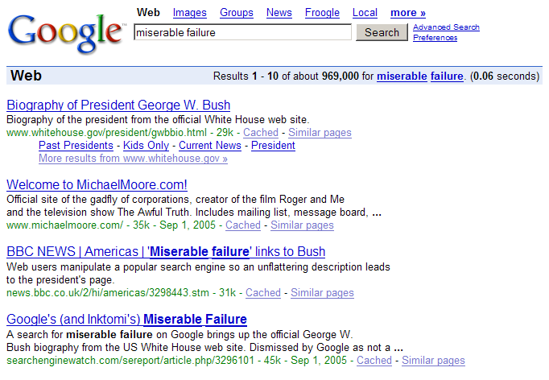
Why it does not work?

Slide 29
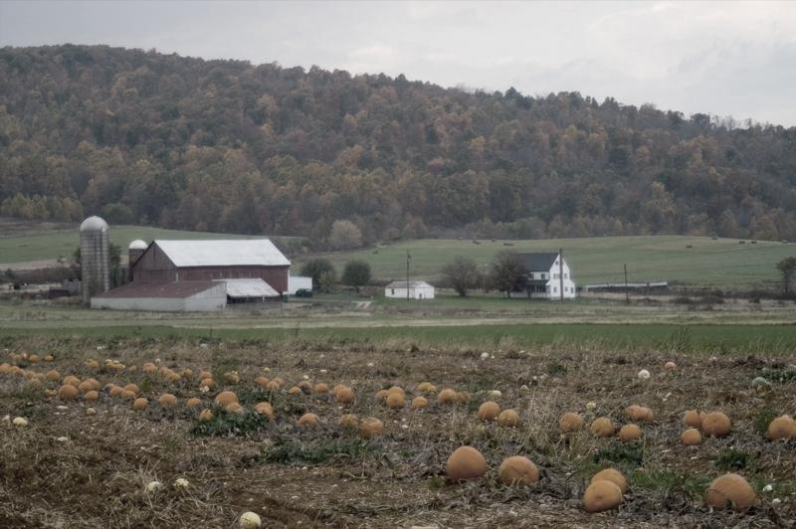
SPAM FARMING

Slide 30
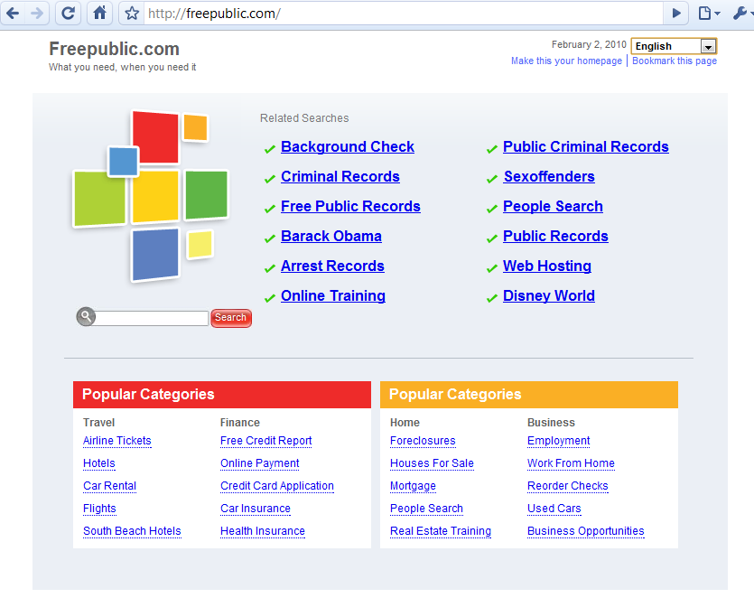
Google vs. Spammers: Round 2!
Once Google became the dominant search engine, spammers began to work out ways to fool Google
Spam farms were developed to concentrate PageRank on a single page
Link spam:
Creating link structures that boost PageRank of a particular page

Slide 31
Link Spamming
Three kinds of web pages from a spammer’s point of view
Inaccessible pages
Accessible pages
e.g., blog comments pages
spammer can post links to his pages
Owned pages
Completely controlled by spammer
May span multiple domain names

Slide 32
Link Farms
Spammer’s goal:
Maximize the PageRank of target page t
Technique:
Get as many links from accessible pages as possible to target page t
Construct “link farm” to get PageRank multiplier effect

Slide 33
Link Farms
Accessible
Owned
Inaccessible
1
t
2
M
Millions of farm pages
One of the most common and effective organizations for a link farm

Slide 34
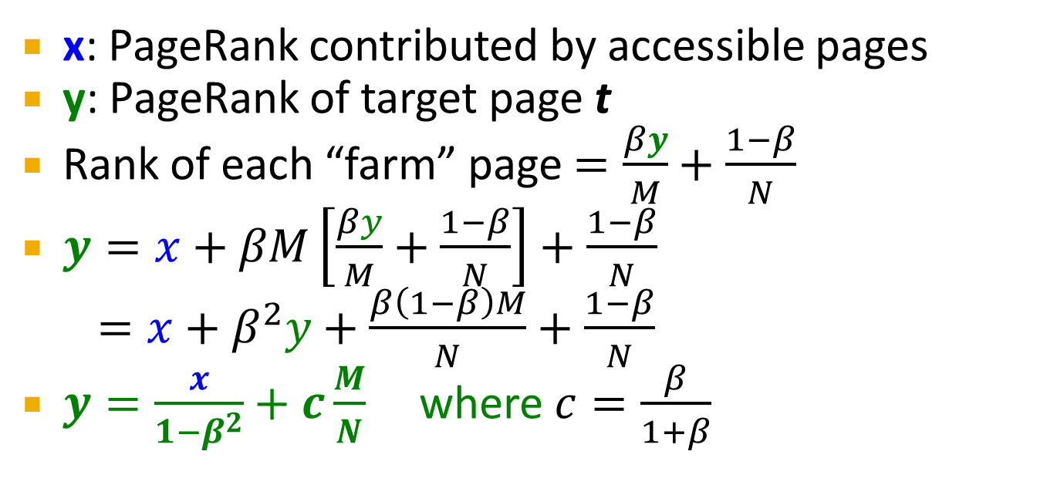
Analysis
Accessible
Owned
Inaccessible
1
t
2
N…# pages on the web
M…# of pages spammer owns
M
Very small; ignore Now we solve for y

Slide 35
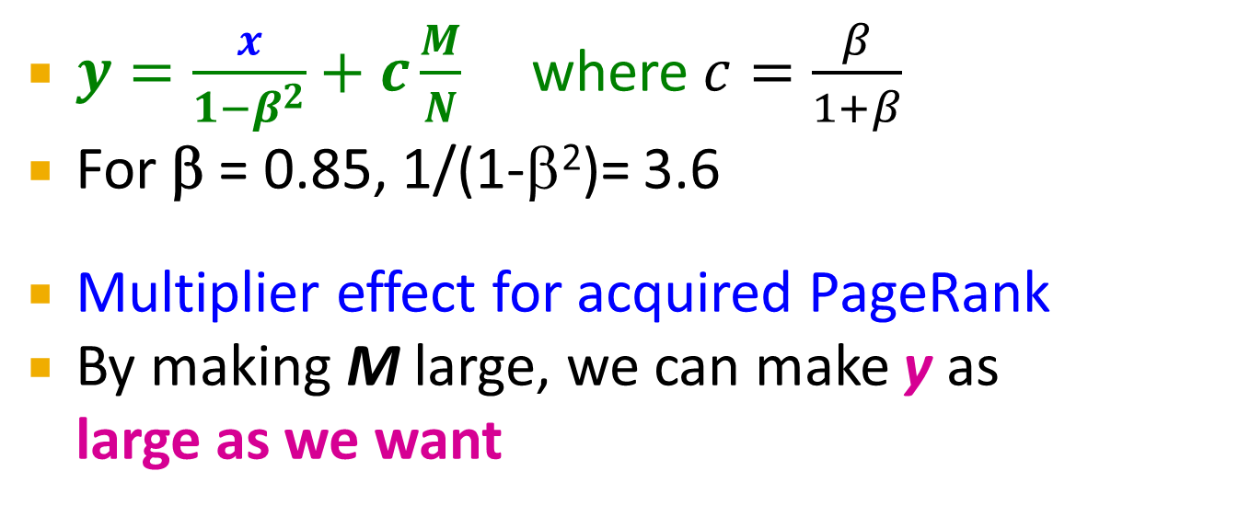
Analysis
Accessible
Owned
Inaccessible
1
t
2
N…# pages on the web
M…# of pages spammer owns
M

Slide 36
TrustRank: Combating the Web Spam

Slide 37
Combating Spam
Combating term spam
Analyze text using statistical methods
Similar to email spam filtering
Also useful: Detecting approximate duplicate pages
Combating link spam
Detection and blacklisting of structures that look like spam farms
Leads to another war – hiding and detecting spam farms
TrustRank = topic-specific PageRank with a teleport set of trusted pages
Example: .edu domains, similar domains for non-US schools

Slide 38
TrustRank: Idea
Basic principle: Approximate isolation
It is rare for a “good” page to point to a “bad” (spam) page
Sample a set of seed pages from the web
Have an oracle (human) to identify the good pages and the spam pages in the seed set
Expensive task, so we must make seed set as small as possible

Slide 39
Trust Propagation
Call the subset of seed pages that are identified as good the trusted pages
Perform a topic-sensitive PageRank with teleport set = trusted pages
Propagate trust through links:
Each page gets a trust value between 0 and 1
Solution 1: Use a threshold value and mark all pages below the trust threshold as spam

Slide 40
Simple Model: Trust Propagation
Set trust of each trusted page to 1
Suppose trust of page p is t_{p}
Page p has a set of out-links o_{p}
For each q∈o_{p}, p confers the trust to q
β t_{p} /|o_{p}| for 0 <β < 1
Trust is additive
Trust of p is the sum of the trust conferred on p by all its in-linked pages
Note similarity to Topic-Specific PageRank
Within a scaling factor, TrustRank = PageRank with trusted pages as teleport set

Slide 41
Why is it a good idea?
Trust attenuation:
The degree of trust conferred by a trusted page decreases with the distance in the graph
Trust splitting:
The larger the number of out-links from a page, the less scrutiny the page author gives each out-link
Trust is split across out-links

Slide 42
Picking the Seed Set
Two conflicting considerations:
Human has to inspect each seed page, so seed set must be as small as possible
Must ensure every good page gets adequate trust rank, so need make all good pages reachable from seed set by short paths

Slide 43
Approaches to Picking Seed Set
Suppose we want to pick a seed set of k pages
How to do that?
(1) PageRank:
Pick the top k pages by PageRank
Theory is that you can’t get a bad page’s rank really high
(2) Use trusted domains whose membership is controlled, like .edu, .mil, .gov

Slide 44
Spam Mass
In the TrustRank model, we start with good pages and propagate trust
Complementary view:
What fraction of a page’s PageRank comes from spam pages?
In practice, we don’t know all the spam pages, so we need to estimate
Trusted set
Web

Slide 45
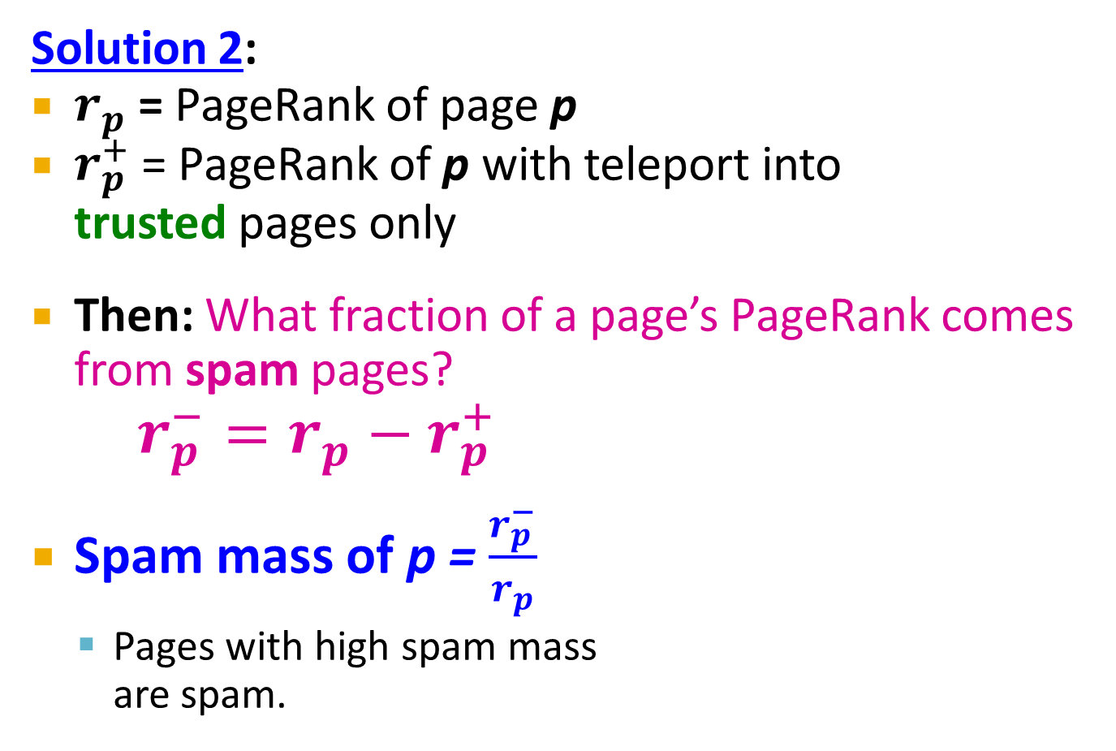
Spam Mass Estimation
Trusted set
Web

Slide 46
HITS: Hubs and Authorities

Slide 47
Hubs and Authorities
HITS (Hypertext-Induced Topic Selection)
Is a measure of importance of pages or documents, similar to PageRank
Proposed at around same time as PageRank (‘98)
Goal: Say we want to find good newspapers
Don’t just find newspapers. Find “experts” – people who link in a coordinated way to good newspapers
Idea: Links as votes
Page is more important if it has more links
In-coming links? Out-going links?

Slide 48
Finding newspapers
Hubs and Authorities Each page has 2 scores:
Quality as an expert (hub):
Total sum of votes of authorities pointed to
Quality as a content (authority):
Total sum of votes coming from experts
Principle of repeated improvement
NYT: 10
Ebay: 3
Yahoo: 3
CNN: 8
WSJ: 9

Slide 49
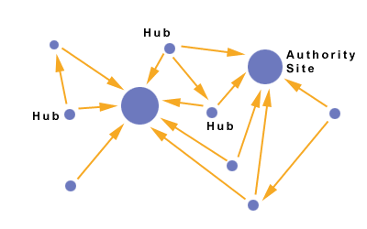
Hubs and Authorities
Interesting pages fall into two classes:
Authorities are pages containing useful information
Newspaper home pages
Course home pages
Home pages of auto manufacturers
Hubs are pages that link to authorities
List of newspapers
Course bulletin
List of US auto manufacturers

Slide 50
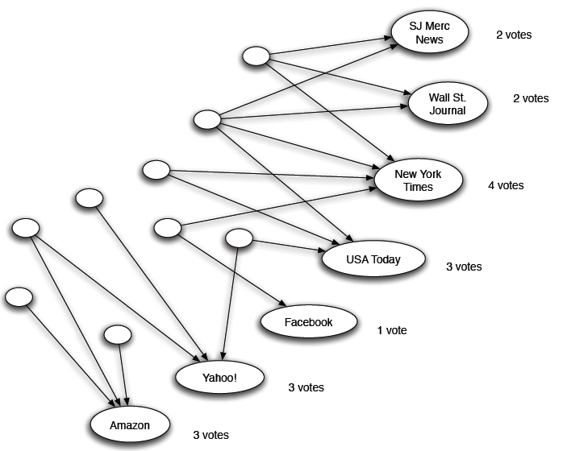
Counting in-links: Authority
Each page starts with hub score 1. Authorities collect their votes
(Note this is idealized example. In reality graph is not bipartite and each page has both the hub and authority score)

Slide 51
Counting in-links: Authority
Sum of hub scores of nodes pointing to NYT.
Each page starts with hub score 1. Authorities collect their votes
(Note this is idealized example. In reality graph is not bipartite and each page has both the hub and authority score)

Slide 52
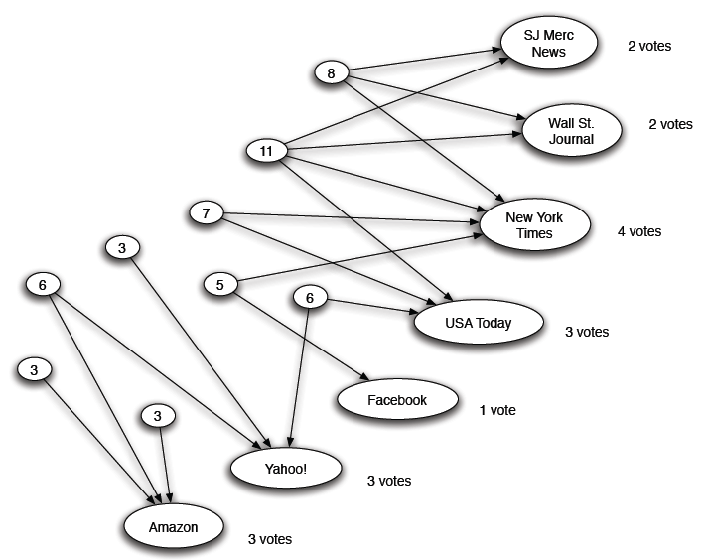
Expert Quality: Hub
Sum of authority scores of nodes that the node points to.
Hubs collect authority scores
(Note this is idealized example. In reality graph is not bipartite and each page has both the hub and authority score)

Slide 53
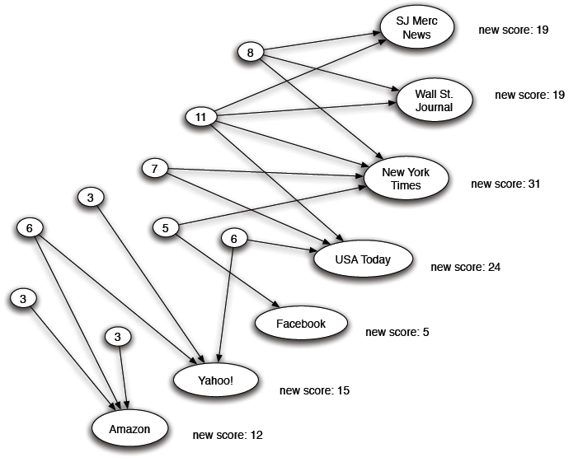
Reweighting
Authorities again collect the hub scores
(Note this is idealized example. In reality graph is not bipartite and each page has both the hub and authority score)

Slide 54
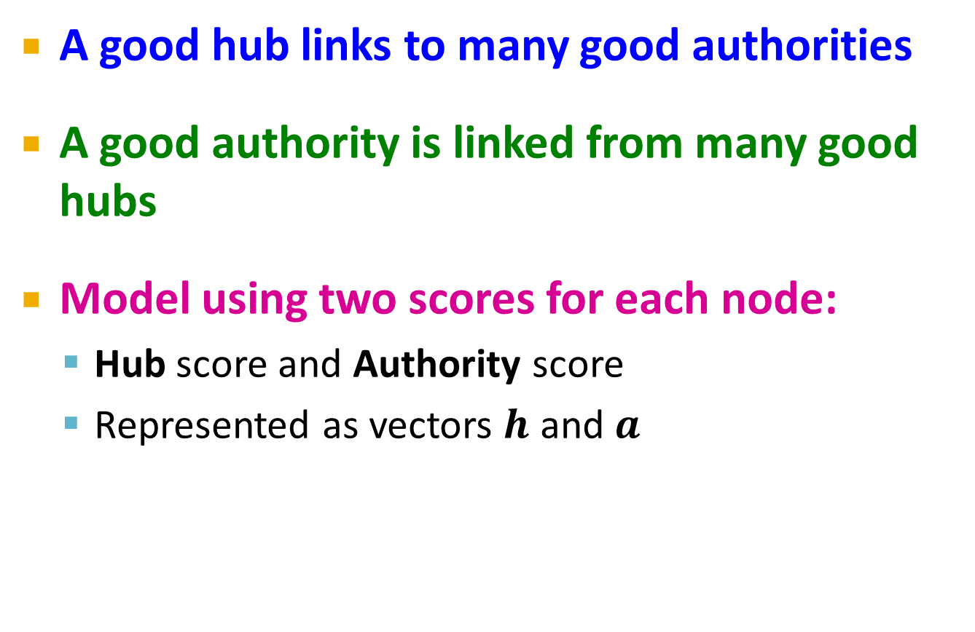
Mutually Recursive Definition

Slide 55
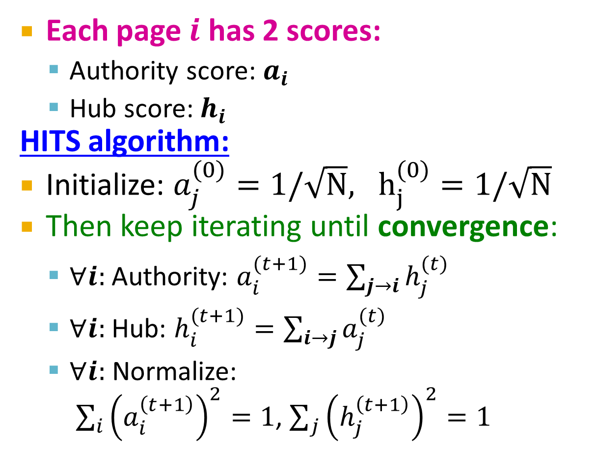
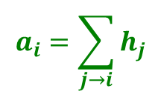
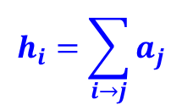
Hubs and Authorities
[Kleinberg ‘98]
j₁
j₂
j₃
j₄
i
i
j₁
j₂
j₃
j₄

Slide 56
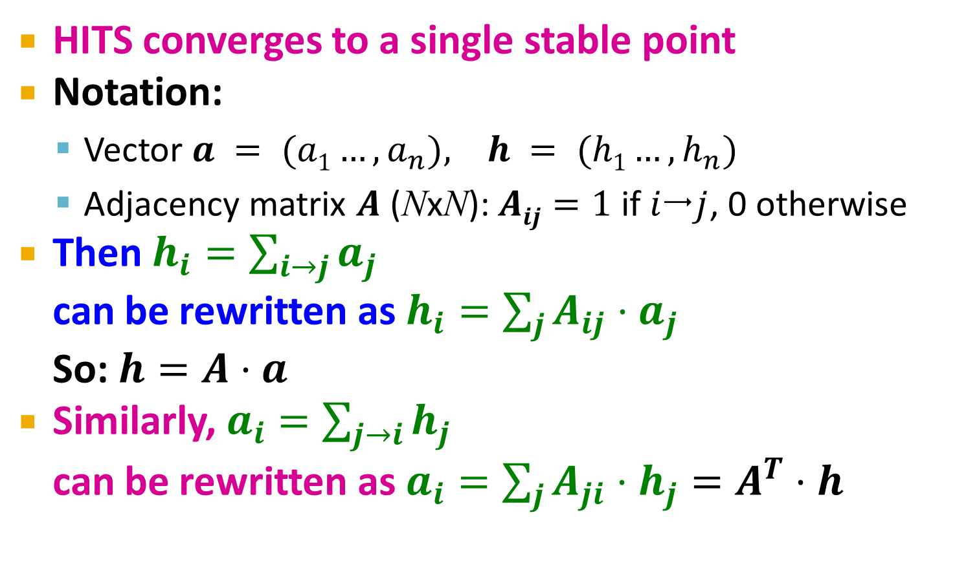
Hubs and Authorities
[Kleinberg ‘98]

Slide 57
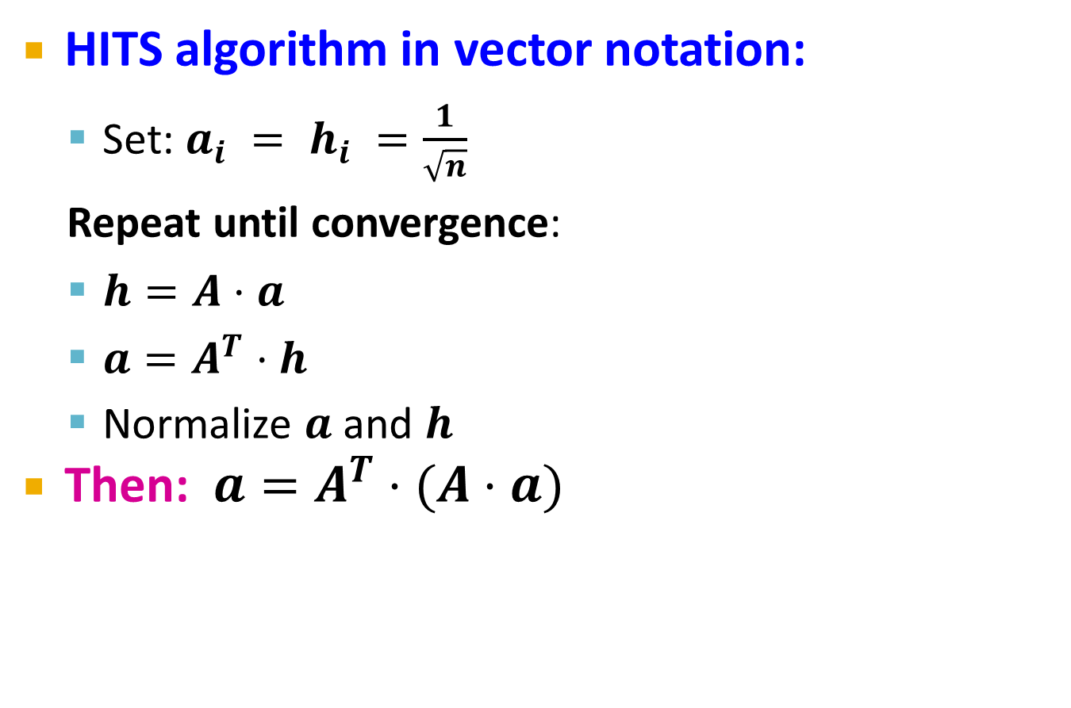
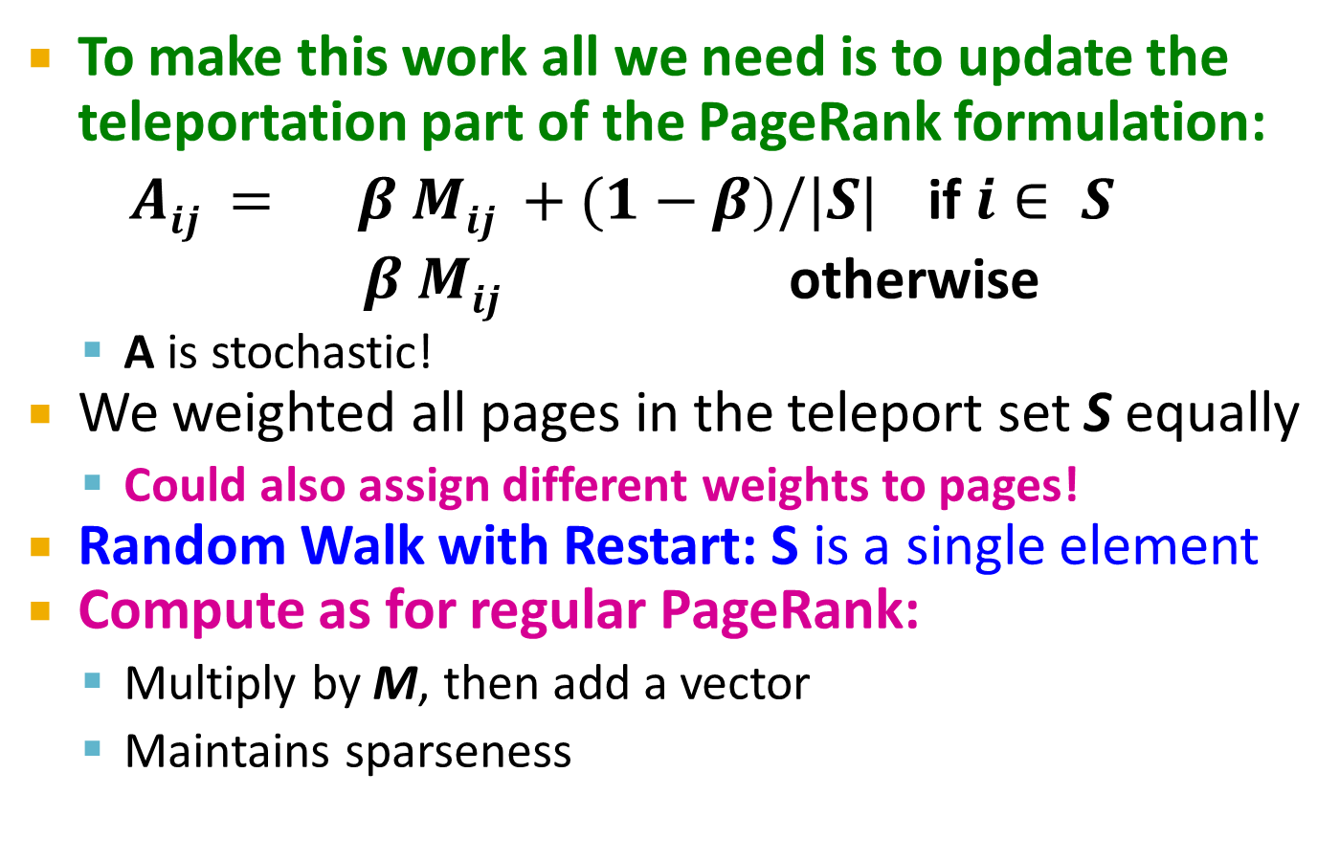
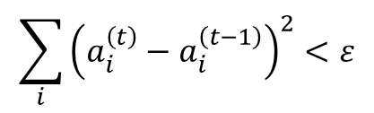
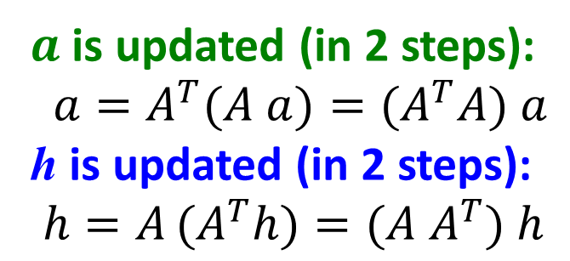

Hubs and Authorities
Convergence criterion:
Repeated matrix powering

Slide 58
Existence and Uniqueness
h = λ A a
a = μ A^{T} h
h = λ μ A A^{T} h
a = λ μ A^{T} A a
Under reasonable assumptions about A, HITS converges to vectors h* and a*:
h* is the principal eigenvector of matrix A A^{T}
a* is the principal eigenvector of matrix A^{T} A
λ = 1 / ∑h_{i}
μ = 1 / ∑a_{i}

Slide 59
Example of HITS
1 1 1
A = 1 0 1
0 1 0
1 1 0
A^{T} = 1 0 1
1 1 0
Yahoo
Amazon
M’soft
h(yahoo)
h(amazon)
h(m’soft)
=
=
=
.58
.58
.58
.80
.53
.27
.80
.53
.27
.79
.57
.23
. . .
. . .
. . .
.788
.577
.211
a(yahoo) = .58
a(amazon) = .58
a(m’soft) = .58
.58
.58
.58
.62
.49
.62
.62
.49
.62
. . .
. . .
. . .
.628
.459
.628

Slide 60
PageRank and HITS
PageRank and HITS are two solutions to the same problem:
What is the value of an in-link from u to v?
In the PageRank model, the value of the link depends on the links into u
In the HITS model, it depends on the value of the other links out of u
The destinies of PageRank and HITS post-1998 were very different

